Slide 1


TECH REPORT
GS490 GENETIC SCHEDULER
John Hokkanen
August 1, 2017
Notes:
This presentation demonstrates the new capabilities of PowerPoint and it is best viewed in Slide Show. These slides are designed to give you great ideas for the presentations you’ll create in PowerPoint 2010!
For more sample templates, click the File tab, and then on the New tab, click Sample Templates.

Slide 2

Problem Recap
Solution
Company plans to solicit 3rd party common carrier bids for freight transport to our stores
Need estimate for annual mileage
Complexity of routing
123 distribution points
Orders delivered same ship day
50-70 deliveries each day
8am-6pm store operating hours
Multiple trucks
Vehicle capacity
Mandatory DOT regulations
GS490 Scheduler
Genetic algorithm
Explores multiple routing options
Optimizing heuristics
Satisfies all constraints
Allows tuning based on corporate needs

Slide 3


Summary of Estimate
Day | Week Total | Mon | Tue | Wed | Thu | Fri
Trucks | 31 | 6 | 5 | 7 | 7 | 6
Volume | 65429 | 10223 | 11537 | 15192 | 15009 | 13468
Miles | 6638 | 1388 | 1370 | 1196 | 1446 | 1238
Labor | 254 | 52 | 55 | 35 | 58 | 53
ON Mins | 538.5 | 37.5 | 87 | 124.5 | 121.5 | 168
Cost | $10,995 | $2,272 | $2,340 | $1,719 | $2,472 | $2,192
$/100ft | $16.80 | $22.22 | $20.28 | $11.31 | $16.47 | $16.28
Mileage Estimates
Annual Mileage: 345K miles

Slide 4
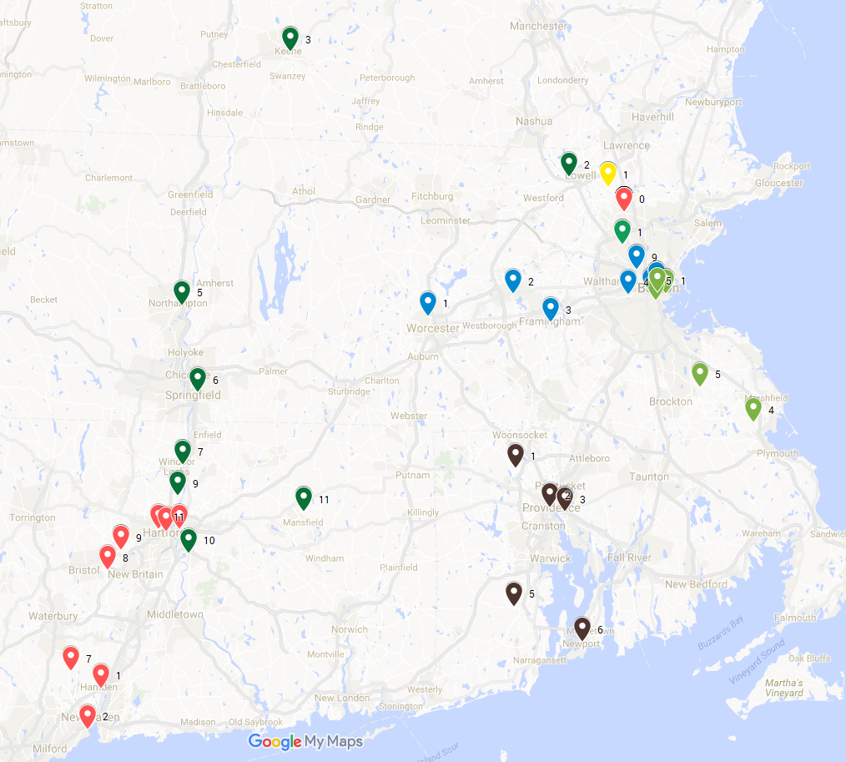

Example Route Map – Typical Wednesday
Route Plan Example
(Wednesday)
The pushpins are the order deliveries, color- coded by vehicle
GS490 groups the GIS-related orders (clustered colors)
Identifies problem cases too
2 orders to Keene, NH
DC

Slide 5

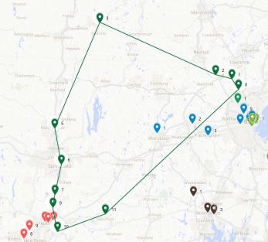
Wednesday
Truck 3 Route Map
Detailed Route
Keene, NH
Wed |  | Truck 3
Stop | OrderID | Location |  | Arrive | Depart | Vol. ft3 | Miles
 |  | DC/Wilmington | MA |  | 7:51:00
1 | 135 | Tewksbury | MA | 8:00:00 | 8:22:00 | 101 | 6
2 | 138 | Lowell | MA | 8:35:30 | 9:05:30 | 159 | 9
3 | 225 | Keene | NH | 10:41:30 | 11:11:30 | 129 | 64
4 | 13 | Keene | NH | 11:11:30 | 11:11:30 | 117 | 0
5 | 231 | Northampton | MA | 12:43:00 | 13:13:00 | 151 | 61
6 | 81 | Springfield | MA | 13:41:30 | 14:11:30 | 140 | 19
7 | 55 | Windsor Locks | CT | 14:34:00 | 15:04:00 | 112 | 15
8 | 220 | Windsor Locks | CT | 15:04:00 | 15:04:00 | 98 | 0
9 | 253 | Windsor | CT | 15:11:30 | 15:41:30 | 94 | 5
10 | 167 | Glastonbury | CT | 16:07:00 | 16:37:00 | 140 | 17
11 | 106 | Storrs Mansfield | CT | 17:10:00 | 17:40:00 | 186 | 22
12 | 193 | Storrs Mansfield | CT | 17:40:00 | 17:40:00 | 118 | 0
13 |  | DC/Wilmington | MA | 20:01:00 |  |  | 94
 |  |  |  |  | Totals | 1545 | 312
A GREAT ROUTE!
Complete route tables and link to interactive map in the report.
Requirements
Volume requirement
Departure requirement
Unloaded by COB
DOT regulations followed
Optimization
Outlier handled
Contiguous short path
Multiple related orders

Slide 6

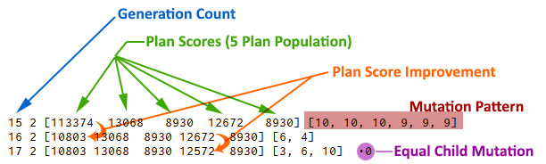
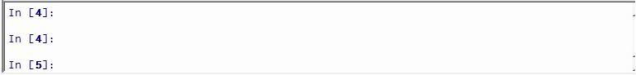
Techniques
Genetic Algorithm – written in Python
Creates n sets of random plans of routes
Utilizes both purely random mutations and heuristic-based mutations to create new plans
Evaluates constantly with the by replacing the existing plans with better plans as they are discovered

Slide 7
Heuristic: Large Order Initialization
Big orders make for great deliveries, BUT,
Many iterations required to randomly obtain a conforming vehicle volume
Much easier to isolate big orders and fill up remaining vehicle volume with small orders
Stop | Veh 1 | Veh 2 | Veh 3 | Veh 4
1 | 195 | 899 | 550 | 742
2 | 420 | 350 | 333 | 500
3 | 555 | 2850 | 600 | 160
4 | 300 | 250 | 386 | 424
5
6
Stop | Veh 1 | Veh 2 | Veh 3 | Veh 4
1 | 195 | 2850 | 550 | 742
2 | 420 |  | 333 | 500
3 | 555 |  | 600 | 160
4 | 300 |  | 386 | 424
5 | 350 |  | 899 | 250
6

Slide 8
Heuristic: Multiple Order Delivery
Big benefits from placing multiple orders together
No extra mileage – free order!
Packages consolidated for unloading – free for small aggregates!
Reduces complexity for the routes
Speeds the optimization process
Implementation
Not a hard and fast initialization or rule
Takes the form of mutation which optimizes slowly with randomness

Slide 9
Heuristic: Relocate Nearby Orders
Benefits of placing nearby orders sequentially
Nearby neighbor is tested heuristic for logistics problems for high yield
Speeds the optimization process
Implementation
Not part of initialization or a hard-and-fast rule
Instead a nearby-order mutation which optimizes slowly with randomness
Mutation takes 1st, 2nd, 3rd, or 4th closest order on probabilistic basis
Placed before or after the selection by random
Assume stop 12 selected, with adjacent stops colored by degree
Most adjacent stop retrieved and placed next to selected stop
Stop | Veh 1 | Veh 2 | Veh 3 | Veh 4
1 | 13 | 12 | 2 | 5
2 | 10 | 4 | 14 | 3
3 | 15 | 8 | 1 | 11
4 | 9 | 7 | 6 | 16
5
6
Stop | Veh 1 | Veh 2 | Veh 3 | Veh 4
1 | 13 | 12 | 2 | 5
2 | 10 | 6 | 14 | 3
3 | 15 | 4 | 1 | 11
4 | 9 | 8 |  | 16
5 |  | 7
6
This slow-learning approach explores many route possibilities!

Slide 10
Heuristic: Equal Child Rule
Issue
Genetic algorithms can get stuck on local minimum as they improve
Problem arises that a plan paints itself in a corner where the mutations cannot create enough change simultaneously to make an improvement
Heuristic
As between a parent and child plan, we do not know which one has better structure
We do know that the parent has not created a better offspring
Therefore, always replace a parent with an equal-scoring offspring
This is not an exploitation heuristic, but a search exploration heuristic.

Slide 11
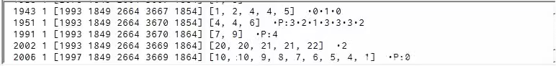
Heuristic: Simulated Annealing Offspring
Issue
Genetic algorithms can get stuck on local minimum as they improve
Simulated annealing seeks to avoid this problem by accepting worse solutions during search phases and better solutions in exploitation phases
Heuristic
If a parent has failed to create a better or equal offspring within a specified period, then accept a less-fit offspring
The more generations that pass, the less fit (using a linear calculation) the offspring may be
A simple rule, but it appears to help keep plans from getting stuck

Slide 12
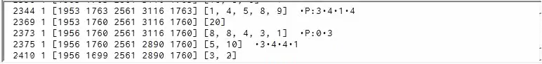
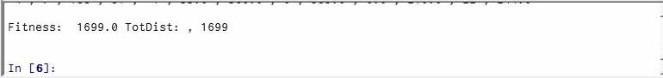
Heuristic: Patterns of Mutation
Issue
In natural world, species adapt to specific pressure (e.g., a predator)
Multiple stresses can cause species failure because offspring are not fit enough
Multiple mutations and edge swaps of routes can generate many inferior routes
Heuristic
Mutation profile is like exposing a species to a different pressures
A individual stop move is not the same kind of modification as a swap of series of stops from one vehicle with another series in a different vehicle
To explore the search space, profiles have different mutation patterns:
These patterns help avoid creating inferior individuals from change overload
They exploit different kinds of route improvements
Apply these in a random way

Slide 13
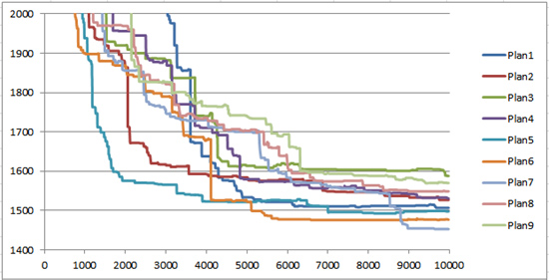
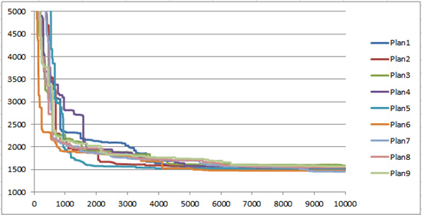
Performance Assessment
Improvement Opportunities
Include classic simulated annealing technique
Expansion of mutation profiles
Examine mutation profiles to see whether search or exploitation
Add more exploitation heuristics (like package breakup)
You can see that plans do not get stuck.
Sometimes they get worse, and then better
They all descend, more or less, at a similar rate as a group.
In this case, at the end of 10,000 generations, 2/3 are within 5% of the best plan
As they approach the global minimum, some may get stuck - unknown
Nine independent plans over 10,000 generations
As you can see, they all improve from a random state fairly rapidly.

Slide 14

FOLLOW-UP
GS490 GENETIC SCHEDULER
Questions? Comments? Send me email!
John Hokkanen
john@hokkanen.com
Notes:
This presentation covers the GS490 Genetic Scheduler for NE Home Goods.

